Slide 1
Mutual Inductance, Dot Convention, Differential Equations, and S Domain Model
Linear Circuit Analysis II
EECE 202

Slide 2
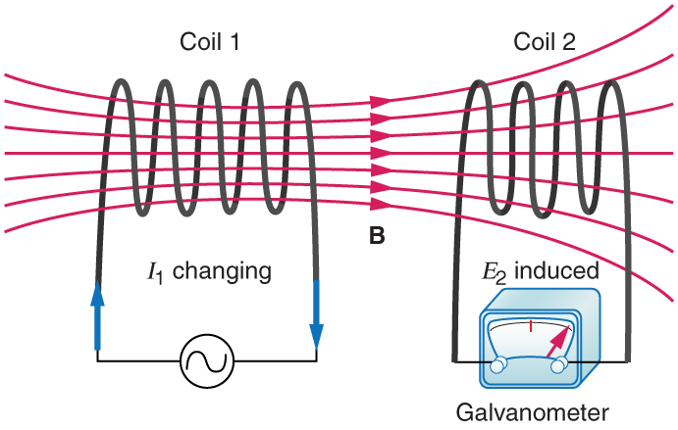
Mutual inductance

Slide 3
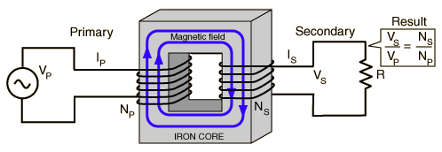
Transformers
https://www.youtube.com/watch?v=d7InRZokfzY&t=11s

Slide 4
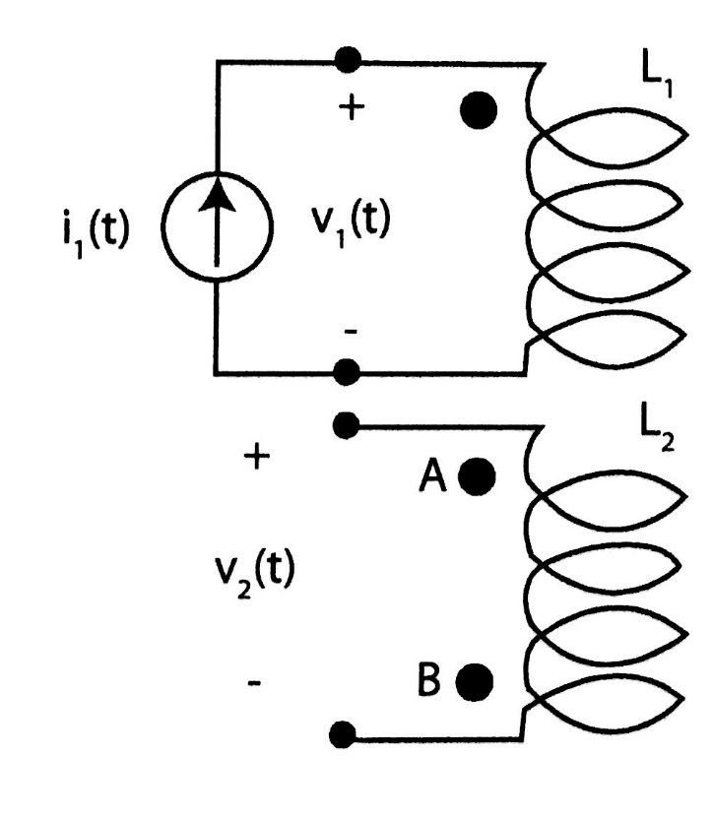
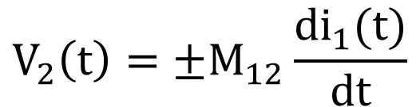
Mutual inductance
$$V_{2}\left(t\right)=±M_{12}\frac{di_{1}(t)}{dt}$$
L - is the coil inductance
M - is the mutual inductance

Slide 5
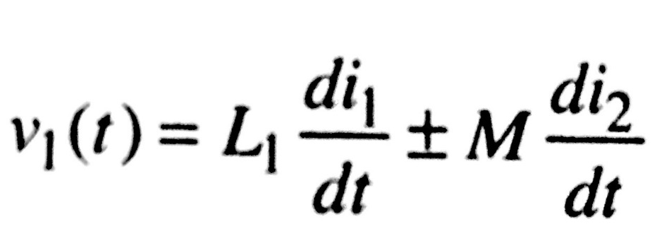
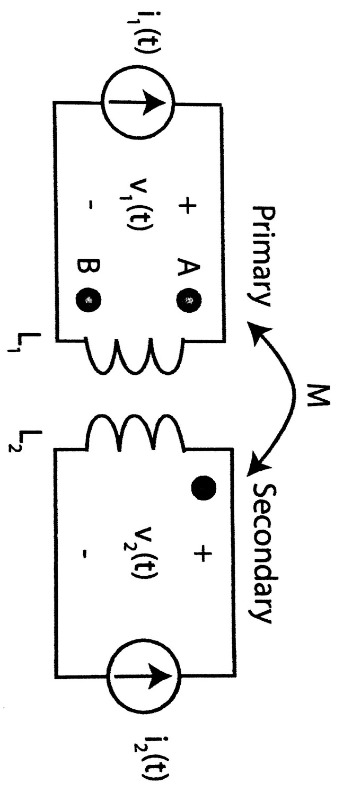

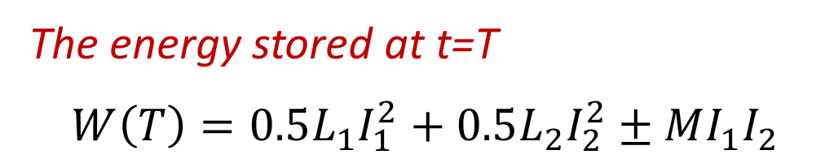
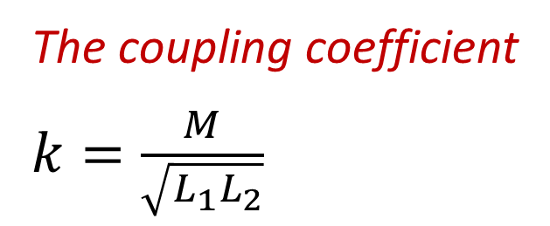
Mutual inductance equations in the time domain
The coupling coefficient
$k=\frac{M}{\sqrt{L_{1}L_{2}}}$
The energy stored at t=T
$$W\left(T\right)=0.5L_{1}I_{1}^{2}+0.5L_{2}I_{2}^{2}±MI_{1}I_{2}$$

Slide 6
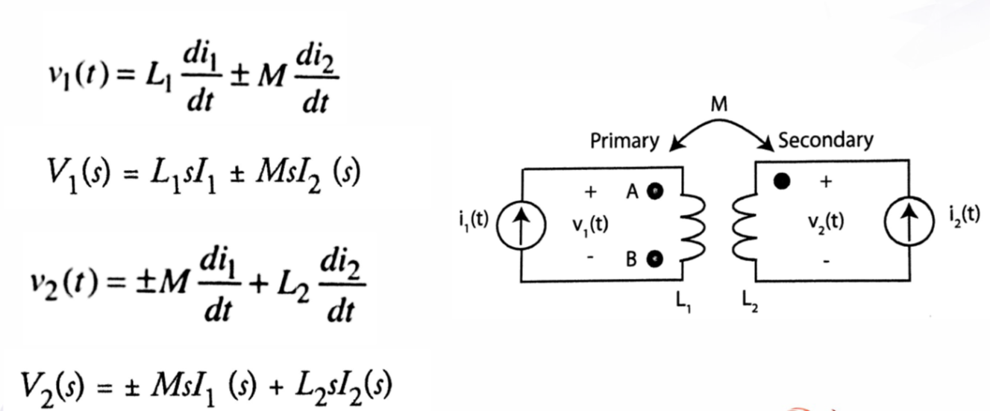
Mutual inductance equations in the Laplace domain

Slide 7
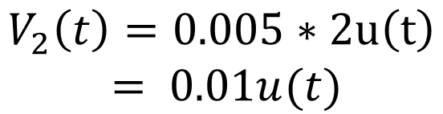
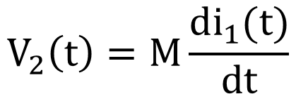
Example
In the shown figure, if i1(t)=2tu(t) A and M=0.005H. Determine the value of V2(t).
(The dot is at position A)
$$V_{2}\left(t\right)=M\frac{di_{1}(t)}{dt}$$
I2(t)
$$V_{2}\left(t\right)=0.005∗2u\left(t\right)$$
$$= 0.01u(t)$$

Slide 8
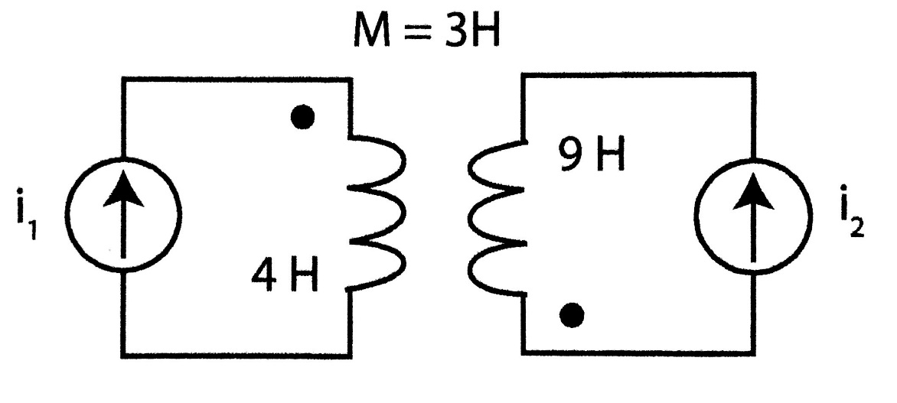
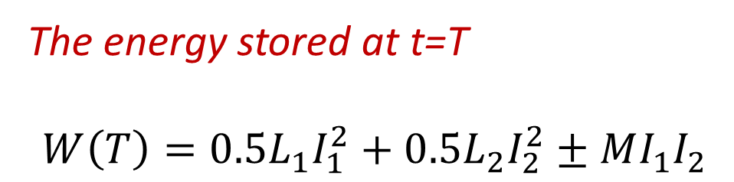
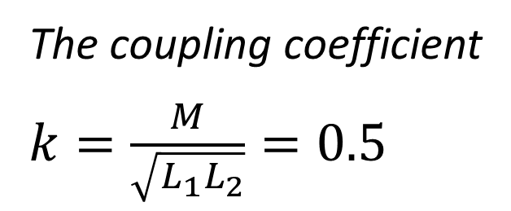
Example
For the shown figure, i1(T)=6A and i2(T)=2A . Find the coupling coefficient (k) and the energy stored by the inductors at t=T.
The coupling coefficient
$k=\frac{M}{\sqrt{L_{1}L_{2}}}=0.5$
The energy stored at t=T
$$W\left(T\right)=0.5L_{1}I_{1}^{2}+0.5L_{2}I_{2}^{2}±MI_{1}I_{2}$$

Slide 9
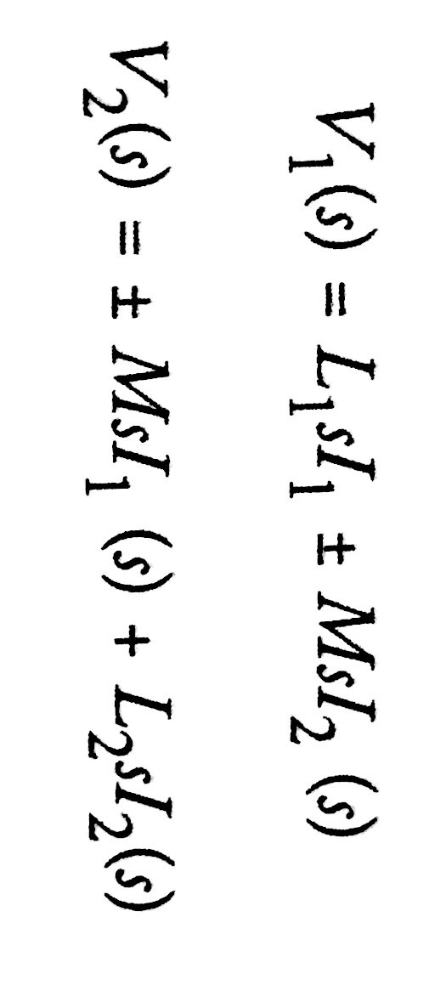
Mutual inductance equations in S-domain

Slide 10
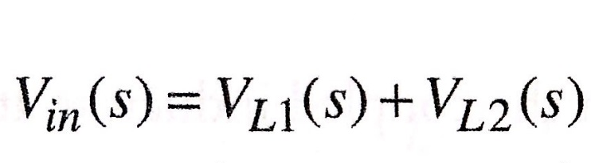

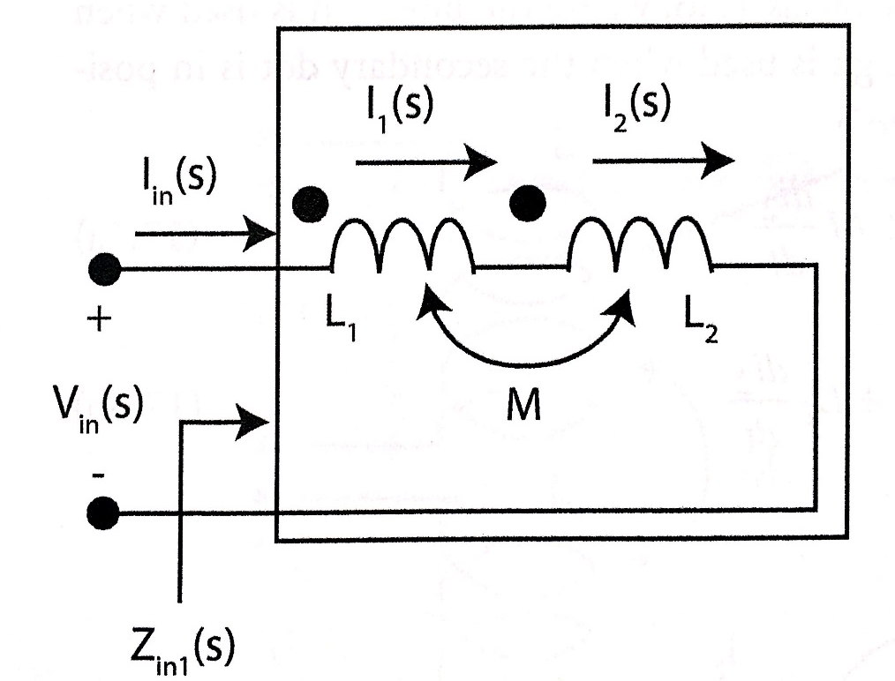

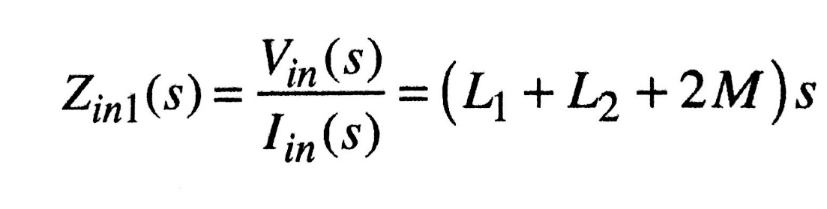
Example
For the circuit shown, Find the input impedance Zin.

Slide 11
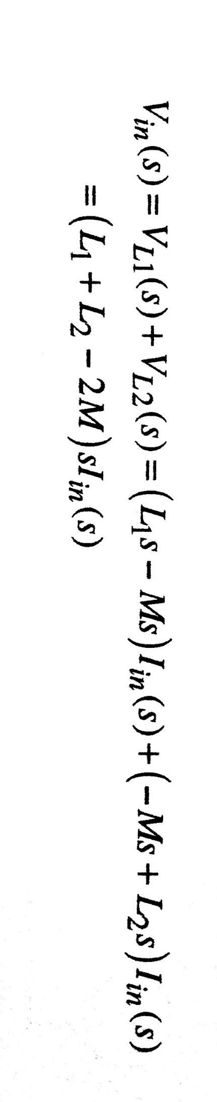
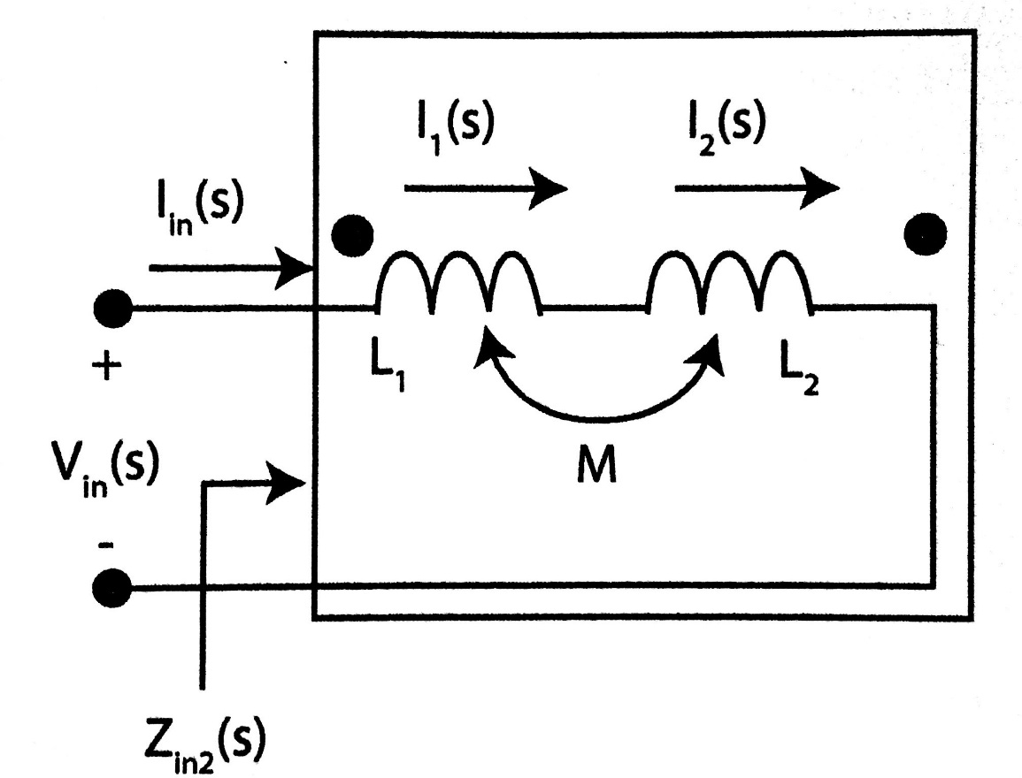
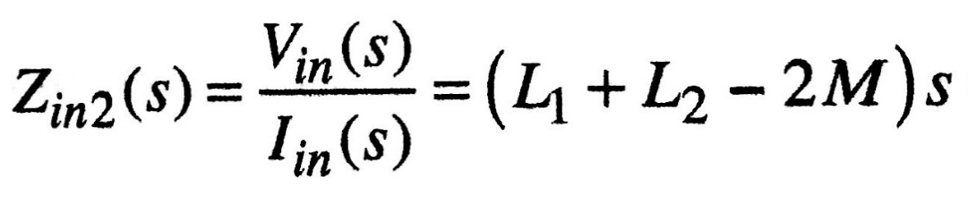
Example
For the circuit shown, Find the input impedance Zin.

Slide 12
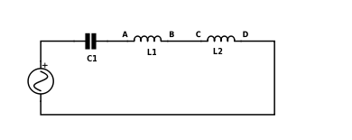
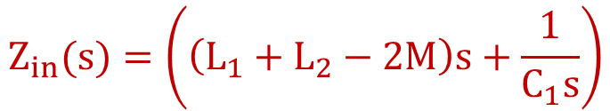
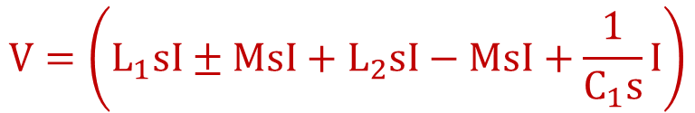
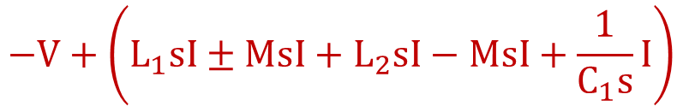
Example
For the circuit shown, Find the input impedance Zin(s). Consider the mutual inductance effect between L1 and L2 where the dots are at B and C.
$$−V+\left(L_{1}sI±MsI+L_{2}sI−MsI+\frac{1}{C_{1}s}I\right)$$
$$V=\left(L_{1}sI±MsI+L_{2}sI−MsI+\frac{1}{C_{1}s}I\right)$$
$$Z_{in}(s)=\left(\left(L_{1}+L_{2}−2M\right)s+\frac{1}{C_{1}s}\right)$$

Slide 13
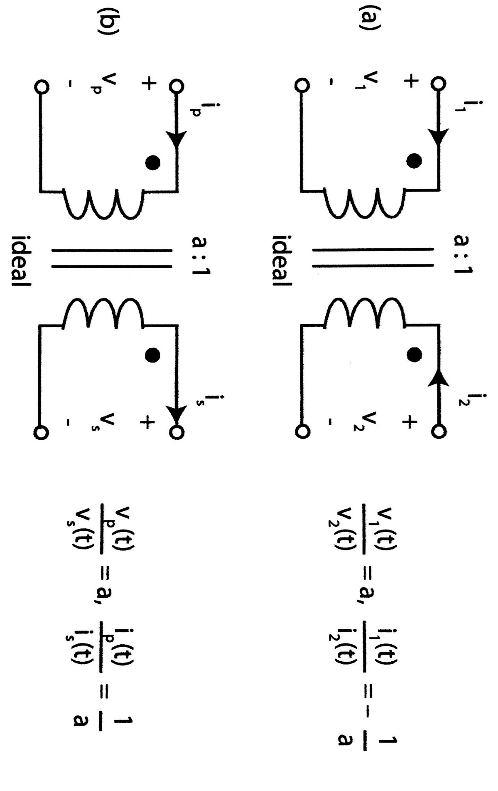
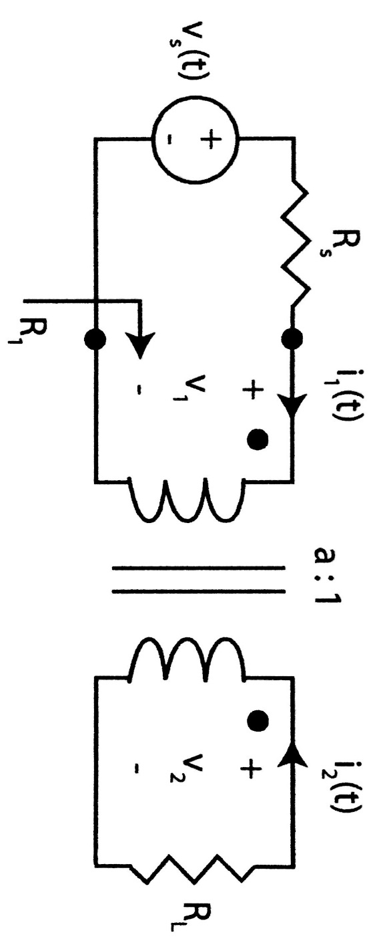
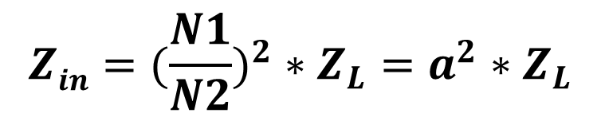


Ideal Transformers
$$a=\frac{N1}{N2}$$
$$Z_{in}$$
$$Zin=(\frac{N1}{N2})^{2}∗Z_{L}=a^{2}∗Z_{L}$$

Slide 14
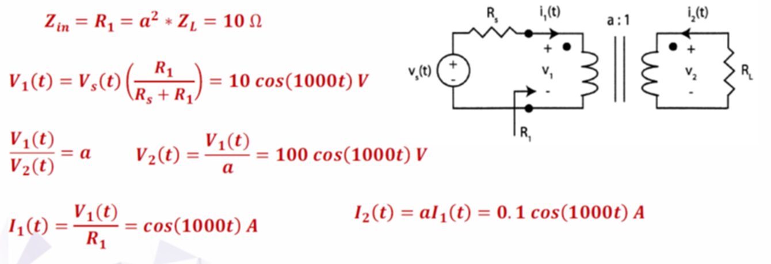
Example
For the circuit shown, Rs=10Ω, a=0.1, RL=1kΩ and Vs=20cos(1000t). Find R₁, V₁, V₂, I₁ and I₂.

Slide 15
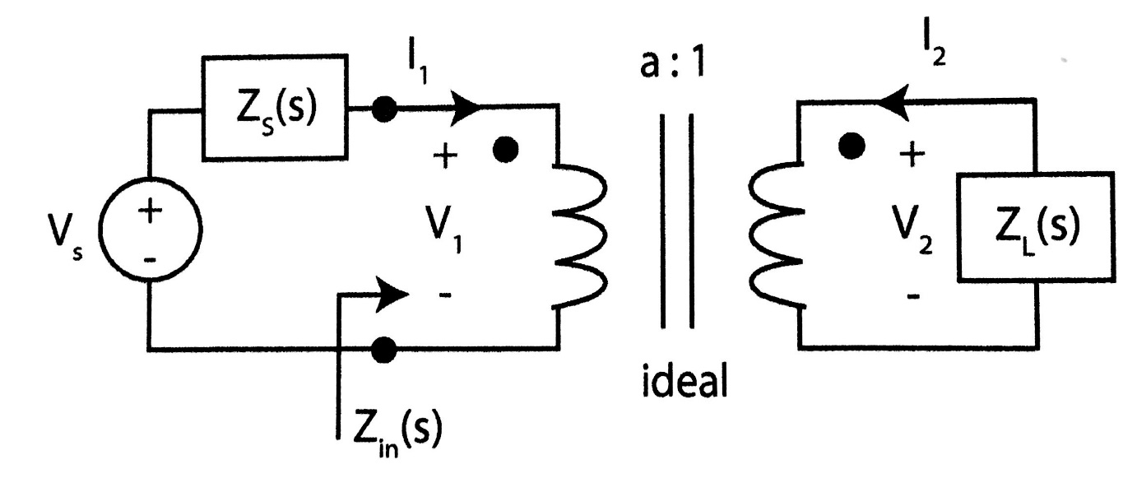
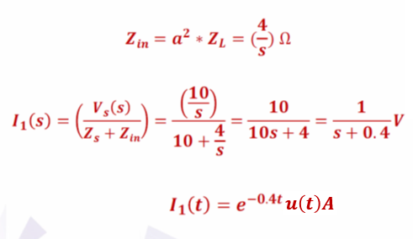
Example
For the circuit shown, if Zs=10Ω, Z_{L}=(1/S), Vs(t)=10u(t) and a=2. find I₁(s) and I₁(t).

